Slide 1
Color Settings Survey

Slide 2
Survey monkey: color settings results
Summary:
Based on 76 respondents of this survey, the top reasons why color settings are use is to distinguishing environments (77%) and to adhere to corporate branding standards (77%). This is followed by users needing to make content more readable (59%) and those wanting to make the interface more visually appealing (51%).
We asked if users agreed with the following statement : “If RSA Archer offered a clean, neutral, user friendly interface, I would not need to adjust the color settings. (Assuming you will have ways to distinguish environments)”. 26% of respondents neither agreed or disagreed, 22% strongly disagreed, 21% disagreed, 20% agreed, and 11% strongly agreed.
Many respondents said they had requests from other partners to change color settings. Most of these requests were for branding purposes.
Disclaimer:
Although this survey’s intent was related to color setting capabilities specific to the Admin appearance settings, based on several responses, participants potentially interpreted color settings to include custom code and chart color options within reports.
Several responses came from same IP and appeared multiple time. Duplicate answers coming from the same IP addresses were removed.

Slide 3
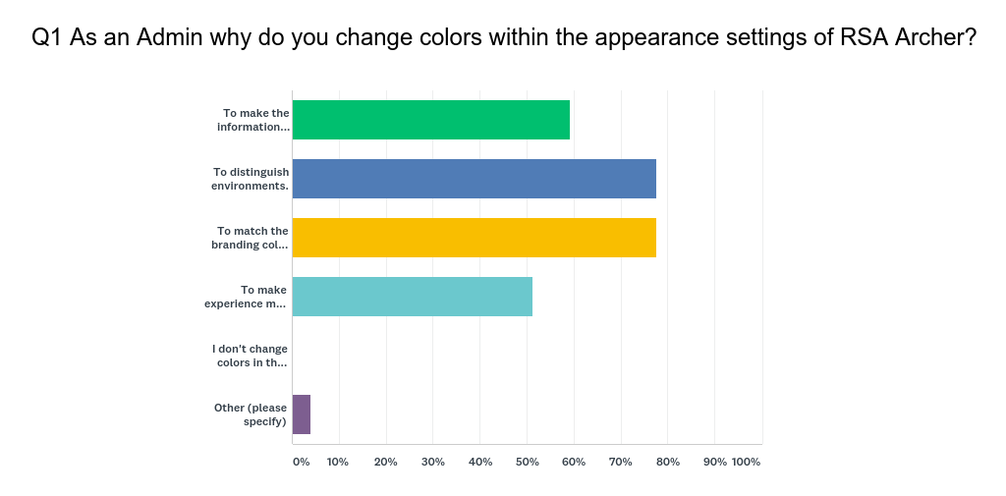
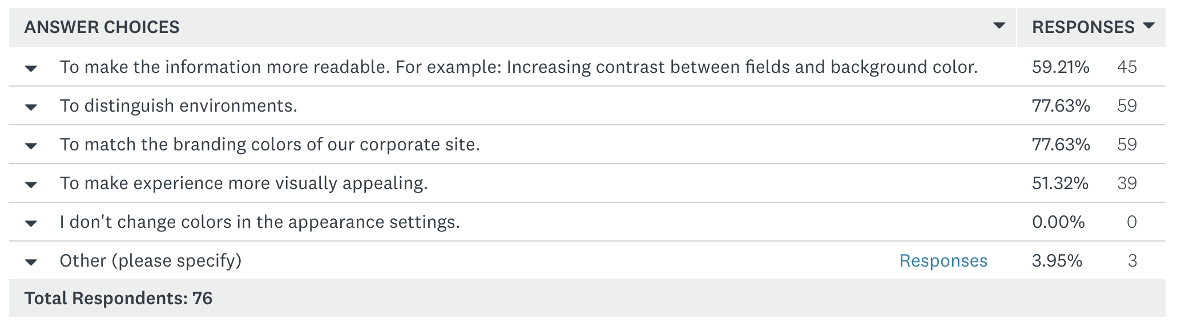
Make information readable
Distinguish environments
Branding
Visually appealing
Don’t change
Other

Slide 4
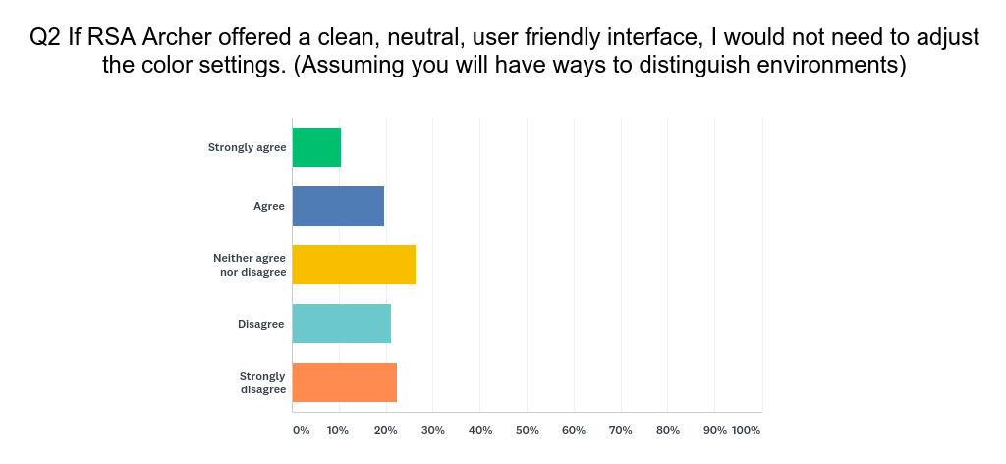
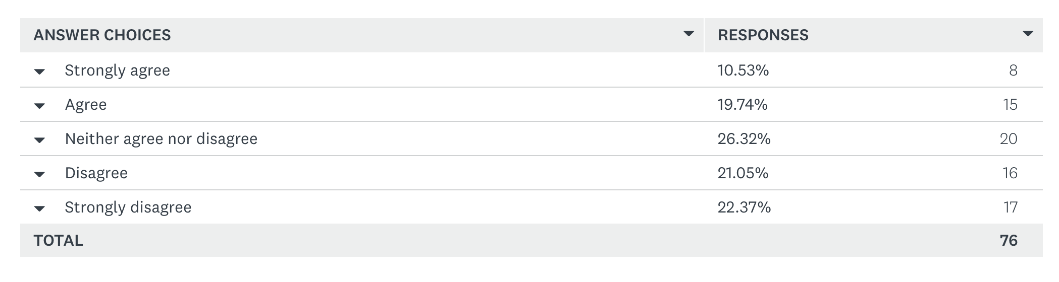
Strongly Agree
Agree
Neither Agree or Disagree
Disagree
Strongly Disagree

Slide 5
Motivations for Changing color settings
Branding
“Owners of the use cases that require third party access want the UI to match our branding colors.” (multiple responses)
“We need to make it match corporate color settings or we need to seek an exception from our corporate branding group.”
“For production sites the UI matches our branding colors, which is important given we have third parties who access our site.”
“Companies have specific branding requirements and at times require specific colors to be used. Limiting the ability to change colors of Archer would be problematic in meeting corporate requirements.”
Distinguish Environments
“only to distinguish environments”
“for the different environments and letterheads on emails so during testing it is easy to test emails.”
“We have standard colors for each of our environments - DEV, QA, PROD. This helps developers, testers, etc. understand where they are in the process. We were able to find a color close enough for PROD to match our company’s needs. we would not change colors from a stakeholder’s request as we want to remain standard for all users.”
Mostly to distinguish my Production / Development / Test instances from each other. Not to mention I have two Production instances.
“…In the past, I have seen business users (or technical ones) who have access to both Production and non-Production (eg. for Testing), mistakenly think they are in one environment (eg. test) and end up making changes in production (or vv). In spite of having a mini banner on the bottom of the screen, and a short descriptor on the browser tab. People rarely look there.... the colour is a clear obvious differentiator.”
Readability and Contrast
“To change the background color of the form so that the data will be highlighted with contrast color and asked for borders for fields and sections”
“Several users provided feedback regarding too much ‘white space’ that was introduced with 6.x. With 6.5 bringing back the contrast between fields and background, this was alleviated.”
The request is more on making UI more user friendly. Starting 6.x version, Archer UI has become more vanilla and not user friendly.

Slide 6
Thank you!

